Slide 1

Product Roadmap Prioritization Using AI
Tanvi Bhosale

Slide 2
Introduction
Product management is at the heart of successful innovation, requiring teams to carefully prioritize initiatives that balance customer needs, business objectives, and resource constraints.
Traditional methods often rely on manual analysis and subjective inputs, which can lead to time consuming process, inefficiencies and misaligned decisions.
This project proposes an AI-driven decision-support tool to streamline the creation of product roadmaps with data-driven insights and dynamic prioritization.

Slide 3
Problem statement
Utilizing AI to automate and optimize the roadmap prioritization process in product management to overcome the existing time-consuming and error prone methods by considering various factors like customer feedback, market trend and team inputs.

Slide 4
objective
To develop a tool that aggregates and analyses inputs such as customer feedback, competitor data, and team recommendations.
To implement a scoring framework that evaluates roadmap initiatives based on business impact, feasibility, and urgency.
To provide an intuitive visualization of the prioritized product roadmap, enabling stakeholders to make informed decisions efficiently.

Slide 5
KEY FEATURES
Data-Driven Insights: Aggregates and processes diverse inputs to derive actionable insights for roadmap prioritization.
Scoring Framework: Customizable metrics to evaluate initiatives based on predefined criteria (business impact, feasibility, urgency).
Visualization: Dynamic dashboards to display prioritized roadmaps, trends, and data insights for collaborative decision-making.

Slide 6
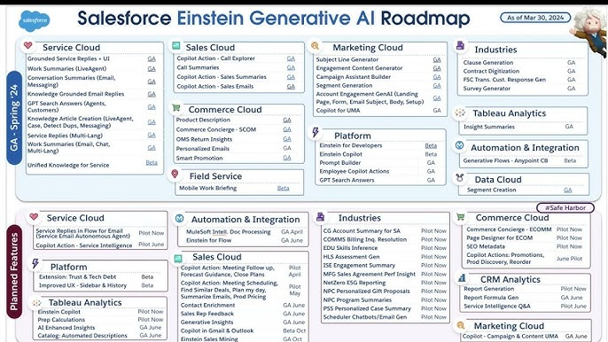
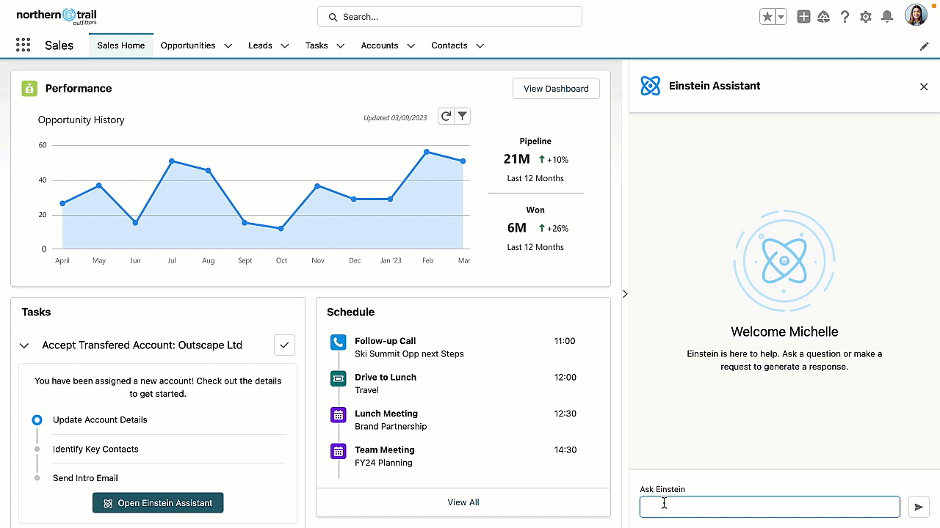
REAL TIME EXAMPLE
SaaS platform Salesforce heavily utilizes AI, specifically through its "Einstein" platform, to inform and enhance its product roadmapping process, leveraging data analysis and predictive capabilities to identify key areas for development and prioritize features based on customer insights and trends; effectively using AI to guide its product strategy.
Einstein AI: The core AI technology within Salesforce, allowing for data analysis and predictive modeling to identify potential customer needs and market trends.

Slide 7
EXPECTED OUTCOMES
Reduction in manual effort for roadmap prioritization by 30%.
Enhanced alignment of product initiatives with business goals, by reducing time consumed in decision making and giving more time in strategic planning for the product.
Improved decision-making efficiency through real-time insights and dynamic updates.

Slide 8
VALUE PROPOSITION
This project bridges technical expertise and strategic product management by addressing a critical challenge in the industry. It showcases proficiency in leveraging AI for actionable insights, creating a scalable solution that aligns roadmap prioritization with organizational goals. The tool's dynamic, data-driven approach sets a new standard for efficient decision-making in product management.

Slide 9
REFERENCES
Gerdsri, N. (2007). "Roadmapping in the Fuzzy Front-End of Innovation." Technology Management for Emerging Technologies.
Lee, T. (2021). "Data-Driven Decision Making in Product Management." Journal of Product Management Research.
Gnanasambandam, C., Harrysson, M., Singh, R., & Yarlagadda, C. (2024). "How generative AI could accelerate software product time to market." McKinsey & Company. https://www.mckinsey.com/industries/technology-media-and-telecommunications/our-insights/how-generative-ai-could-accelerate-software-product-time-to-market
"Artificial Intelligence Index Report 2023." Stanford University. https://aiindex.stanford.edu/wp-content/uploads/2023/04/HAI_AI-Index-Report_2023.pdf
"AI-Driven Product Management Strategies for Enhancing Customer Experience in Mobile Applications." The Science Brigade. https://thesciencebrigade.com/cndr/article/view/434

Slide 10
THANK YOU

